Slide 1
Workshop on Heat Health Decisions in the Northeast
Understanding the Heat-Health Information Requirements of Many Different Decision Makers
An initiative of the National Integrated Heat Health Information System (NIHHIS)

Slide 2
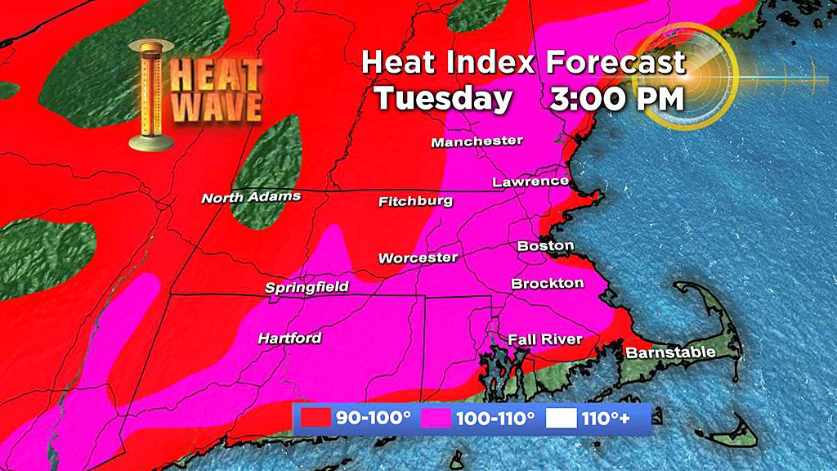
Summers in New England
CBS Boston
Late August heat wave in 2018

Slide 3
Heat Waves will Worsen in a Warming World
Intensity
The recent prolonged (multi-month) extreme heat has been unprecedented since the start of reliable instrumental records in 1895. (NCA 2014)
The intensity of extreme heat events will likely increase. (NCA 2014)
Duration
Model results for areas of Europe and North America show that future heat waves in these areas will be longer lasting in the second half of the 21st century. (Meehl and Tebaldi, 2004)
Over the period 1880 to 2005 the length of summer heat waves over W. Europe has doubled & the frequency of hot days has almost tripled. (Della-Marta, 2007)
Frequency
Model results for areas of Europe and North America... show that future heat waves will become more frequent. (Meehl and Tebaldi, 2004)
Character
Most models project somewhat lower relative humidity on the hottest days, but the combined effect of temperature and humidity changes is substantial increases in heat stress. (Wuebbles et al., 2014)
Attribution
“today about 75% of the moderate daily hot extremes over land are attributable to warming. It is the most rare and extreme events for which the largest fraction is anthropogenic, and that contribution increases nonlinearly with future warming.” (Fischer and Knutti, 2015)
Notes:
Intuitively, and from statistical and dynamical model runs, we know that climate change is a threat multiplier that will make heat waves worse, and will exacerbate the consequences of heat waves.
So the key takeaway from all of this is that heat waves will become more intense, longer-lasting, and more frequent than before. As more and more heat waves occur every year, attribution studies are increasingly confident in an anthropogenic signal in these extreme events. Areas where research could still be very helpful is understanding how heat waves may change in character in certain places, and how they may change in terms of their distribution throughout the hot season – will there be more earlier in the summer, or later in the summer?
Do climate models simulate heat waves – as in, do they appear during model runs as actual phenomena?

Slide 4










Extreme Conditions: Heat (NIHHIS)
NOAA and CDC launched the National Integrated Heat Health Information System (NIHHIS) in June of 2015 to address heat across timescales
NIHHIS quickly grew to include representation from several agencies (right) in an interagency working group. The group launched the NIHHIS portal and harmonized heat season outreach.
NIHHIS has also launched regional, trans-boundary pilots to understand local decision-making contexts and needs, and to improve the information.
Ongoing activities include:
Expanding border health network in the south,
‘Decision calendar’ exercises to understand multi-disciplinary needs in the Northeast,
National projects to improve the utility of information.
The National Integrated Heat Health Information System weaves together existing pieces, identifies information needs and helps to develop needed climate services.
NIHHIS will facilitate an integrated approach to providing a suite of decision support services to reduce heat related illness and death
Notes:
Extreme heat is a global challenge that will only increase with a changing climate. It is an often overlooked problem, described by many as a ‘silent killer’, but its effects on human health, animal health, and infrastructure can be just as crippling as an earthquake or tsunami. A variety of approaches to managing the risk associated with extreme heat have been employed around the world, using different information sources, and serving different vulnerable populations. Yet, extreme heat continues to kill tens to hundreds of thousands per year. the heat wave of summer 2003 in Europe for example, more than 70 000 excess deaths were recorded ^{(WHO)} The National Integrated Heat Health Information System seeks to integrate these approaches by providing a framework for understanding the risk, information needs, and potential interventions that reduce risk on timescales from early warning (when a heat wave is imminent) to long-term planning.

Slide 5
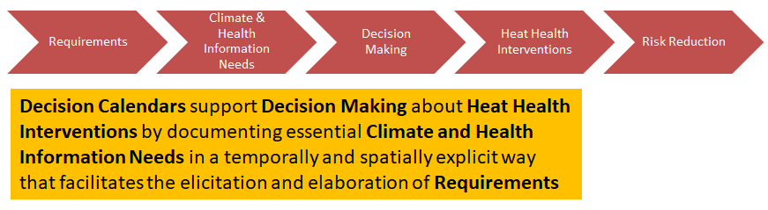
Workshop Goals
Build and strengthen the network between a multidisciplinary set of heat-health decision-makers through relationship and awareness building.
Identify and document locally-contextualized interventions at the planning and preparedness timescales, with important considerations noted.
Discipline-specific decision makers will use planning scenarios to explore decision contexts behind the identified interventions, and specific information needs will be documented to support decisions in the form of decision calendars.

Slide 6

Extreme Heat’s Health Impacts
Discomfort
Reduced labor productivity
Psychological distress
Exacerbation of preexisting chronic conditions
Heat exhaustion
Heat cramps
Heat stroke
Death

Slide 7
Basic Risk Terminology
RISK
HAZARD
VULNER-ABILITY
EXPOSURE

Slide 8
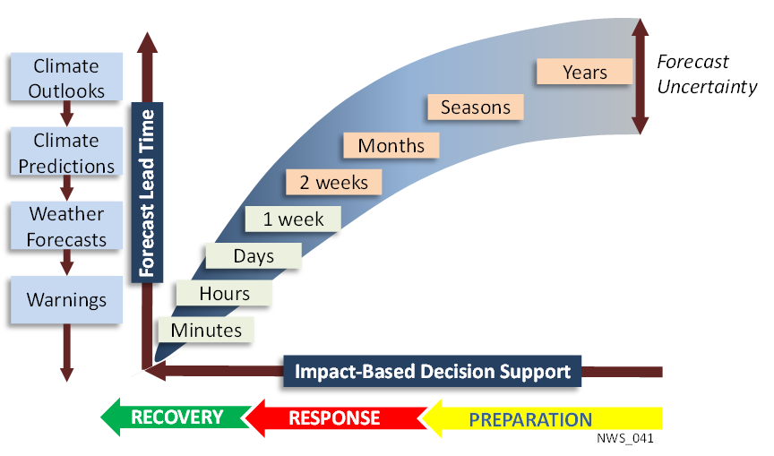
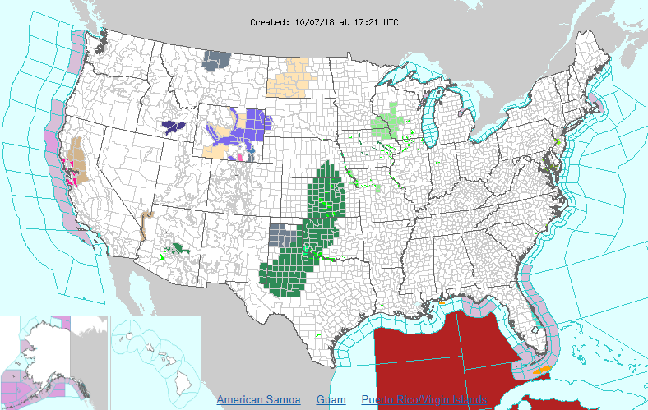
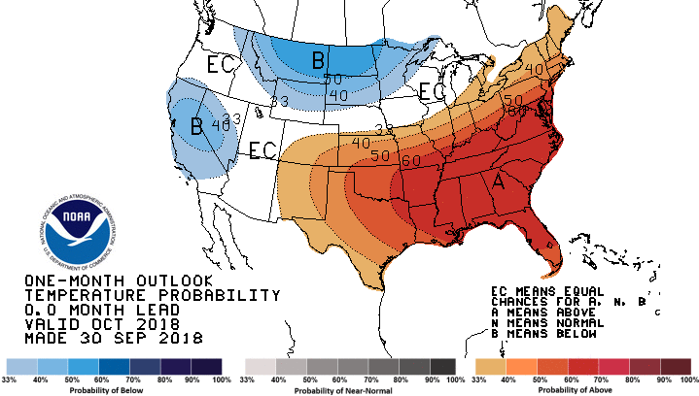
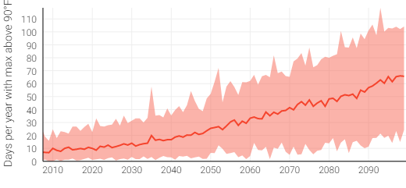
Understanding decision timescales

Slide 9
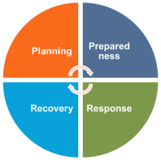
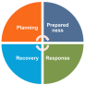
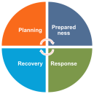
Heat Health Risk Management Annual Cycle
Planning
Prepared-ness
Response
Recovery
Analysis of historical impacts & climate observations
Scenario-based planning & climate predictions
Previous Years
Future Years
What can we learn from past experiences to improve heat health planning and preparedness?
How might our current approach fail under future climate stressors, and how can we prevent such failure?
Notes:
Elaborate on activities at each timescale, information needs, other dependencies, and downstream activities.

Slide 10
Heat Event Decision Calendar – Annual Cycle
Planning (October – March; Out Years)
Annual planning; resource allocations; annual budget; resilience & sustainability studies
Preparing (April-May)
Spring heat season preparedness and messaging for heat season
Responding (June – August)
Weeks to days before event – prepositioning assets & messaging.
Duration of Event – ongoing support, monitoring, communication, rapid response.
Immediately Following – recovery.
Recovering (June – September)
Longer-term recovery during heat season to bounce back to ready status.
Hot wash immediately after heat season.
Template
Notes:
1 Year Term

Slide 11
Heat Event Decision Calendar – High Level
Planning & Budgeting (October – March)
Seasonal temperature anomaly outlooks and advice on climate modes such as ENSO are available. Climate norms and longer term predictions also available for longer-range planning. Other information for planning available on NIHHIS.
Preparing (April-May)
Seasonal heat outlook available for preparations, updated monthly, as well as outlooks at the Weeks 3-4, and Week 2 range. General communications and messages available via NWS and NIHHIS, as well as detailed preparedness information in the latter.
Responding (June – August)
Weather forecasts and longer term predictions at the S2S timescale available. Alerts issued by local WFO.
Ongoing monitoring and updating provided by local WFO to support action.
De-activating heat alert
Recovering (June – September)
Heat events and mortality outcomes are documented in Storm Events with a month or so lag time.
For significant events, NOAA NWS will perform analysis, and NOAA NESDIS will include in State of the Climate
Current Information Available from NOAA
Notes:
1 Year Term
Marty Hoerling Attribution – heat wave climate & Stephanie Herring (3-4 major events and relation to climate)
It’s Marty’s area of research so he can be asked to look into
Hil codes
State climatologist
Sea grant and risa connection (MARISA person or ccrun)
BRACE
State health officials
RPCs
Matt Kelly
Mass RPC
Decisions, information, other aspects

Slide 12
Decision Calendars
Decision calendars are a framework to organize information about user context in decision-making. They document what needs to be known when, by whom, and with what certainty in order to take actions to reduce heat health risk.
Planning and Preparedness Lead Times
1-2 Weeks
< 1 Week
Active Heat Wave
3-4 Weeks
Pre-Heat Season
Inter-annual
Long Term
Emergency Manager
Selecting New Sites
Launch Heat Awareness Campaign
Targeted Outreach to Pops of Concern?
Open Cooling Centers?
Urban Planner
Plant Trees?
Rooftop Albedo Modifications
Environmental Decision-Support Information
Where will the Urban Heat Island Effect be the greatest?
Where is the UHI effect currently the greatest?
Characterize the heat season relative to previous or analog years
Detect likely heat event in the coming few weeks
Weather service issues heat advisory
For more information see: Ray, A. J., & Webb, R. S. (2016). Understanding the user context: decision calendars as frameworks for linking climate to policy, planning, and decision-making. Climate in Context, 27–50. doi:10.1002/9781118474785.ch2

Slide 13
Workshop Process
Phases
Outcomes
Decision-Maker Talks
Breakout Work-Sessions
I
Risk Mgmt. Actions
Round 1 Understanding the Problem Domain
Round 1 Mapping populations, risk factors, & actions
Concept Mapping
I
Decision Making
Round 2 Understanding Decisions and Timescales
II
Round 2 Decisions and decision-makers plotted on timeline
Decision Timeline
II
III
Climate Scenarios
Round 3 Formalizing Information Needs
Round 3 Information needs mapped to timeline and verified
Stress Testing
III
Decision Calendars
The workshop opens with a primer on the process for developing decision calendars that will be followed throughout the day, as well as a brief overview of the heat health climate context. The meeting then proceeds through three cycles of lightning talks and breakout groups which will successively build decision calendars, first through concept mapping, and then using a timeline.

Slide 14
Breakout Sessions Overview
There will be three breakout sessions that will progressively build decision calendars based on risk scenarios. Participants can self-select the tables they would like to sit at, but we ask that you consider the following:
Expertise: Please sit at the table where you think you can contribute the most expertise
Diversity: Please try to avoid sitting at the same table as your colleagues or those in the same discipline.
Balance: We are aiming for 6 equal tables, so please aim for 5-7 people per table.
Breakout 1: Concept Mapping [Populations, Risk, Actions]
Breakout 2: Decision Calendars
Breakout 3: Shocks and Stressors

Slide 15

Breakout Groups (Risk Categories)
Group A Outdoor Active Exposure This group will focus on decisions which must be made to protect people who must be exposed for work or play, such as emergency responders, athletes, and military personnel. [Sean Birkel] | Group B Outdoor Incidental Exposure This group will focus on decisions which must be made to protect people while they are exposed incidentally – in transit to other places, or engaged in leisure or neighborhood activities. [Bill Solecki] | Group C Indoor Exposure This group will focus on decisions which must be made to protect people while they are in homes and other buildings, including elderly care facilities or schools. [Ellen Mecray]
Group D Physiological Vulnerability This group will focus on decisions which must be made to protect people who experience heightened vulnerability due to physiological constraints due to age, medication / drug use, or temporary concerns such as a lack of acclimatization. [Pat Kinney] | Group E Behavioral Vulnerability This group will focus on decisions which must be made to protect people who are at greater risk because of their behaviors, which with proper education and awareness, can be modified to reduce risk. [Tonna-Marie] | Group F Disability & Limited Agency This group will focus on decisions which must be made to protect people with disabilities or limited agency (those who depend on others) as well as those who may have fewer means (lower income) or less access to services. [Hunter Jones]
Exposure
Vulnerability
During breakouts, individuals will be assigned to groups based on risk factors which must be managed to protect people from extreme temperatures. Each risk categories may contain multiple risk factors, and may be linked to multiple vulnerable groups. A set of interventions may be employed to manage these risk factors.

Slide 16
Components for Modeling
Breakout Round 1
Breakout 2
Population of Concern
Any group of people with shared characteristics who are at heightened risk of heat health impacts.
Decision Maker
Any person who is charged with making decisions and taking actions to manage risk in a population of concern.
.
Risk Factor
A characteristic of a person or group that increases their vulnerability or exposure to the hazard of excessive heat.
.
Information Need
Climate, weather, or health information needed to inform a decision regarding a risk management action.
!
Risk Management Action
Any health intervention or other action which can be taken to address risk factors and reduce risk in a population.
Breakout 3
Assumption
A thing held constant and believed to be stable for the duration of an action (e.g. the power will be stable and adequate to run A/C units.
?
Decision Point
A question which must be answered in order to implement a risk management action.

Slide 17
Instructions Breakout 1 - Concept maps
Concept maps are used to represent relationships between things.
They are composed of very basic elements: shapes and connectors.
Homeless Population
How many needed to have effect?
High Temperatures
Exposure to
What kind of trees?
Exacerbated by
Increase Urban Tree Canopy
Where to place trees?
Urban Heat Island (UHI) Effect
Reduces
For round 1, do not worry about who takes the action or what information is needed to inform decisions about the action.

Slide 18
Instructions Breakout 2 – Decision Calendars
Place Decisions on Timeline
How many needed to have effect?
Increase Urban Tree Canopy
Landscape and Ecology Studies
What kind of trees?
UHI Future Projections
Where to place trees?
Current UHI Map
Vulnerability Map
Parks Dept Staff
Consider the many climate, health, and other information sets that are required in order to inform the implementation of the risk management actions.

Slide 19
Instructions Breakout 3 – Stress Testing
How many needed to have effect?
Stable Climate Supports Chosen Tree Species
Landscape and Ecology Studies
Increase Urban Tree Canopy
Invasive Species do not damage trees.
What kind of trees?
UHI Future Projections
Stable budget supports tree planting
Current UHI Map
Where to place trees?
Population dynamics don’t’ shift
Vulnerability Map
Parks Dept Staff
Consider the many climate, health, and other information sets that are required in order to inform the implementation of the risk management actions.

Slide 20
Talks Guidance
Each lightning talk will be allotted 10 minutes – 7 for speaking and 3 for questions.
Slides are optional, but I assume most of you will use them. If you do, please have them to me by end of day, Monday the 15th.
These talks will set up the breakouts that immediately follow them.
Though the topics covered will differ, I hope that each presentation can cover:
What is your role in managing heat health risk, and what decisions or actions do you take to do so?
What unique challenges or opportunities to you foresee for your discipline or in your role managing heat health risk?
How climate-scale information (sub-seasonal, seasonal, annual, decadal) is currently used in planning, and what can be done to improve this information’s utility in decision-making?
Speakers – Please send me a photo and bio.

Slide 21
Lightning Talk Topics
Round 1: Interventions
Cooling Shelters
Urban Greening
Activity Modification
Community Outreach, Information Meetings
HEWS, Social Media, Comms
Caretaker Training
These talks will set up the concept mapping, broadly covering populations, risks, and interventions taken at all timescales.
Round 2: Decision Making
Urban Data and New Technology
Cross-disciplinary Planning and Preparedness
Precision Comms for Populations of Concern
Decision-making Under Uncertainty
These talks set up decision calendars which introduce a time dimension and begin to get to information needs.
Round 1: Climate Scenarios
Climate Extremes
Energy System Risk Management
Health System Risk Management
Adaptive Heat Alerts
These talks will question assumptions loaded into the draft decision calendars, and will introduce unexpected scenarios.

Slide 22
Index of Populations of COncern
Older Adults
Athletes
Outdoor Workers
Homeless
Emergency Responders
Children
Military Service Members
Disabled
Pets
Institution-alized
Communities of Color
Individuals with Chronic Conditions

Slide 23
Index of Decision Makers
Transportation Official
Energy Risk Manager
Health Commissioner
Emergency Manager
Mayor
Chief Resilience Officer
Hospital Administrator
Coach or Trainer
Caregivers for older adults
Construction Managers
City Planners and Architects
Medical Professionals

Slide 24
Risk Factors Hazard, Exposure, Vulnerability
Physiology / Thermoregulation
Medication or Drug Use
Dependence
Social Pressure to Work/Perform
Over-Exertion
Personal Protective Equipment (PPE)
Social Isolation
Low/Fixed Income
Poor Fitness or Acclimatization
Limited Access to Care
Lack of Awareness of Symptoms
Obesity
Dehydration
Sleep Deprivation
Underlying Illness
Alcohol Use
Insolation
Low Air Circulation or Wind
High Humidity
High Temperatures

Slide 25
Interventions
Green Infrastructure
White Roofs
Passive Cooling
Social Cohesion Development
Neighborhood Watches
Cooling Centers
Schedule Changes to Avoid Exposure
Plan for Utility Outages
Increase Health Care Staff
Regulation Changes and Zoning
Mobile Apps
Personal Temperature Monitors
Smart Thermostats
Home Energy Efficiency Assessments (EmPower-NYC and MassSave)
Social Media Campaigns
Caretaker Training
Community Outreach Meetings

Slide 26
Assumptions
Electricity Available
Ability to Understand English
Transportation Infrastructure
Individual Mobility
Ability to Afford Energy Costs
Stable Climate Regime
Telephone Service
Internet Access

Slide 27
Information Needs
High Resolution Urban Heat Island Map
Social Vulnerability Indices
Hospitalization Outcomes by County
Heat Season Outlook (number of heat waves, +/- avg, relative to last year)
Heat Wav Predictions at Lead time 2,3,4 weeks – planning
Heat load forecast (cooling degree days per week)
Wet Bulb Globe Temperature predictions over athletic fields and work sites
..

Slide 28
Population | Examples / Exposure Pathways | Exposure | Principal Protectors
Children | School buildings, playgrounds, sealed vehicles, homes, otherwise unattended outdoor activities, sports leagues | Inside and Outside | Teachers, Parents, Coaches, Daycare
Emergency Responders | Paramedics, fire, police, responding to events
Outdoor Workers | Rooftops, manufacturing, agricultural workers, lawn/garden managers, facilities maintenance,
Athletes | High school, college, professional during training, |  | Sports organizations (YMCA),
Older Adults | Similar to institutionalized, homebound, socially isolated.
Pets | Preventing human caretaking, indoors, vehicles
Institutionalized or otherwise isolated/dependent | Retirement homes, prisons, psychiatric institutions, rehabilitation facilities, homebound, medical device dependency.
Military | Basic training, field operations, National Guard domestic response,
Homeless
Index of Vulnerable Populations

Slide 29
Heat-health Information Use Cases
Information Needs
Early Warning
Scheduling outdoor workers, managing work site supplies, scheduling heat-sensitive procedures.
Resilience
Building material selection, building siting, overall construction project schedule,
Design Considerations
Early Warning
Scheduling outdoor workers, managing work site supplies, scheduling heat-sensitive procedures.
Resilience
Building material selection, building siting, construction schedule,
Construction Managers

Slide 30
Potential NIHHIS Product
Heave Wave Annual Exceedance Probability and 100 Year Return Interval
Just as we use AEPs and Return Intervals to describe floods and earthquakes, employ this method for heat waves as well.
Requirements:
Determine a standard definition of a heat wave – be it absolute or parametric (ex: T-Min 2 STD above climate normal for 2 days).
Determine appropriate climate reference period for historical numbers
Project future climate reference periods.
How might the AEP for given thresholds change over time?

Slide 31

Heat-health Information Use Cases
Hazard and Exposure
Increasing Hazard
Longer, more intense, more frequent heat waves.
Indoor Exposure
Older adults spend much time indoors due to vulnerability characteristics.
Outdoor Exposure
Limited, but potentially activities such as gardening, shopping, etc…
Vulnerability Characteristics
Physiology
Older adults thermoregulate less well due to a variety of factors including pre-existing conditions, medication.
Isolation
Living alone with limited social engagement
Reliance
Many rely on others for support, including being in an institution.
Fixed Income
Inability or unwillingness to pay for energy or other interventions.
Older Adults

Slide 32
Heat-health Information Use Cases
Hazard and Exposure
Increasing Hazard
Longer, more intense, more frequent heat waves.
Indoor Exposure
Older adults spend much time indoors due to vulnerability characteristics.
Outdoor Exposure
Limited, but potentially activities such as gardening, shopping, etc…
Vulnerability Characteristics
Physiology
Older adults thermoregulate less well due to a variety of factors including pre-existing conditions, medication.
Isolation
Living alone with limited social engagement
Reliance
Many rely on others for support, including being in an institution.
Fixed Income
Inability or unwillingness to pay for energy or other interventions.
Psychology
Peer Pressure to Perform
Athletes

Slide 33
Breakout Table A: Outdoor Active Exposure
This group will focus on decisions which must be made to protect people who must be exposed to extreme heat for work or play, such as emergency responders, outdoor workers (roofing contractors, farmers, etc…), athletes, and military personnel.
Characteristics:
Exposed at worksite, athletic field, remote locations
Personal Protective Equipment (PPE) a factor
Examples include Emergency Responders, Military, Athletes, Outdoor Workers
Potential Actions: Rescheduling to Avoid Exposure, Using modified PPE,
Potential Products: WBGT forecasts,

Slide 34
Breakout A: Outdoor Active Exposure
Please record your name so that we can track who was in each group.

Slide 35
Breakout Table B: Outdoor Casual Exposure
This group will focus on decisions which must be made to protect people who choose to be outdoors for leisure activities or exercise, or who are incidentally outdoors because of an activity they are engaged in such as shopping, or commuting. This may also include those who are exposed but do not have control of their exposure, such as the homeless population or children.
Characteristics:
Exposed in state/national parks, urban areas, parking lots
Exposure may be avoidable
Examples include homeless, joggers, hikers, shoppers, commuters, children, pets
Potential Actions: UHI reduction, information campaigns, social media
Potential Products: UHI maps

Slide 36
Breakout Table B: Outdoor Casual Exposure
Please record your name so that we can track who was in each group.

Slide 37
Breakout Table C: indoor Exposure
This group will focus on decisions which must be made to protect people while they are in homes and other buildings, including elderly care facilities or schools. Some people may have limited agency, limited mobility, or limited means.
Characteristics:
Exposed in homes, elderly care facilities, schools, work sites, restaurants, subways
Examples include older adults, schoolchildren, lower income housing residents
Potential Actions: A/C or fan giveaways, energy subsidy, smart thermostats,
Potential Products: UHI maps, home energy forecasts,

Slide 38
Breakout Table C: Indoor exposure
Please record your name so that we can track who was in each group.

Slide 39
Breakout Table D: Physiological vulnerability
This group will focus on decisions which must be made to protect people who experience heightened vulnerability due to physiological constraints due to age, medication / drug use, or temporary concerns such as a lack of acclimatization.
Characteristics:
Examples include older adults, children, drug users (legal and illegal), early season athletes, visitors/vacationers who are not acclimated
Potential Actions: acclimatization programs, information campaigns, targeted messaging (pharmacists),
Potential Products: heat outlooks timed to prescription refills, …

Slide 40
Breakout Table D: Physiological vulnerability
Please record your name so that we can track who was in each group.

Slide 41
Breakout Table E: Behavioral Vulnerability
This group will focus on decisions which must be made to protect people who are at greater risk because of their behaviors, which with proper education and awareness, can be modified to reduce risk.
Characteristics:
Exposed due to lack of planning or oversights
Examples include hikers in national/state parks, children left in cars by parents, etc…
Potential Actions & products: alerts on smart phones, heat outlooks during planning (proactive information/predictions on national/state park pages)

Slide 42
Breakout Table E: Behavioral Vulnerability
Please record your name so that we can track who was in each group.

Slide 43
Breakout Table F: Disability & Limited Agency
This group will focus on decisions which must be made to protect people with disabilities or limited agency (those who depend on others) as well as those who may have fewer means (lower income) or less access to services.
Characteristics:
Exposed in homes, elderly care facilities, socially isolated or homebound elderly residents at home, disabled persons with limited mobility
Examples include older adults, schoolchildren, lower income housing residents
Potential Actions: A/C or fan giveaways, energy subsidy, smart thermostats, home visits during heat waves,
Potential Products: UHI maps, empower map of energy dependent individuals

Slide 44
Breakout Table F: Disability & Limited Agency
Please record your name so that we can track who was in each group.

Slide 45
What’s Next?
The prototype decision calendars developed today will be combined with context from the talks and from other background information to create a synthesized complete decision calendar for heat health risk management.
This interim product will be shared back with meeting attendees for comments and corrections.
A final version of the decision calendar will be prepared and linked to climate and health information requirements and products (existing and potential).
From this documentation of information requirements, existing products can be improved, and new products can be piloted.
Over the next several months, new products will be prepared for piloting during heat season.

Slide 46
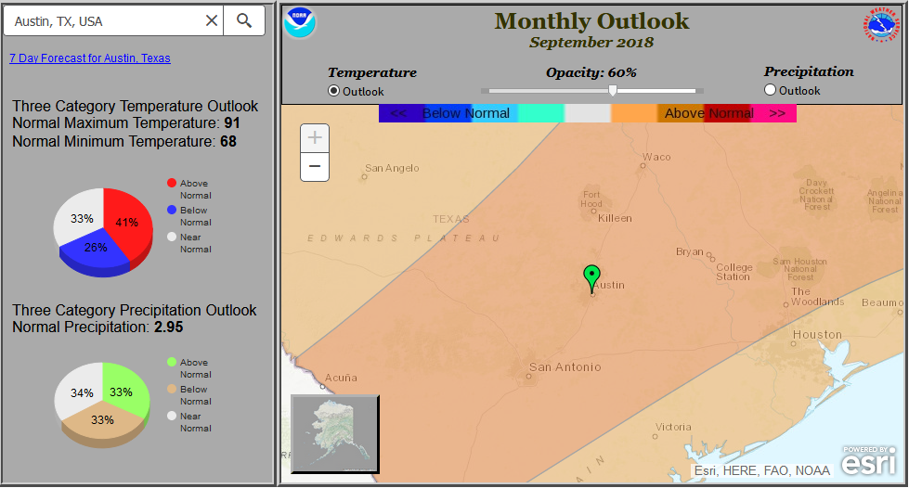
This is an example of the information that is provided now. You can get the probability that the temperatures will fall in the upper, lower, or middle tercile of climatological norms. So in this case, a slight chance that temperatures will be above normal in Austin in September, but not a strong signal. [http://www.cpc.ncep.noaa.gov/products/predictions/long_range/lead14/interactive/index.php]

Slide 47
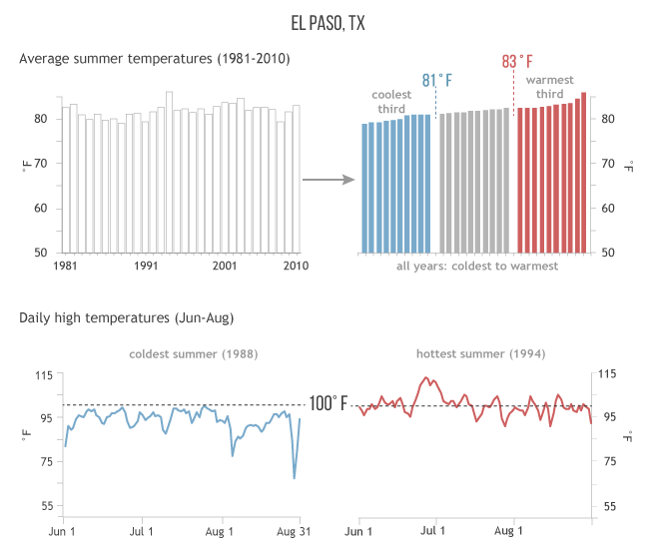
This explainer piece will help you understand how to interpret this information
https://www.climate.gov/news-features/understanding-climate/where-are-highest-chances-hot-summer-2017

Slide 48
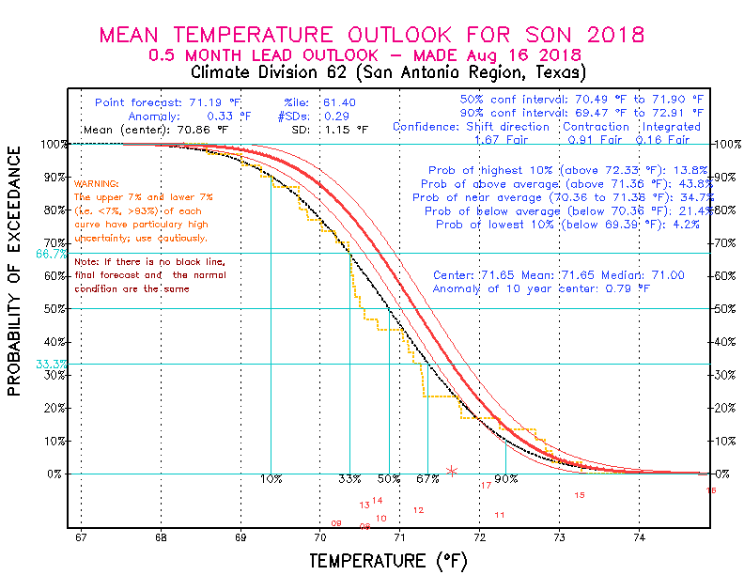
Here’s another view of similar information, but by season, if you think that might be more useful. It shows the information as a curve, so you can see the probability distribution. So it looks like we could go with a best guess of the temperatures being .79F above average this fall (SON).
I wonder if I could get NOAA’s Climate Prediction Center to produce a POE curve like this for their monthly predictions. I think this would be most useful.

Slide 49
Here’s a crude example of what we could show in an energy bill:
Current Month (August) Average Temperature
2017
81.1 F
82.0 F
Average September Temperature
2018
Predicted Average Temperature Next Month
2018
83.5 F
76 77 78 79 80 81 82 83 84 85 86 87 88 89
Mean temperature for the month of September in Austin, TX is expected to be 1.5F warmer than the average September, and this translates to a potential increase of $23 in your energy bill compared to last September, based on your energy use history.

Slide 50
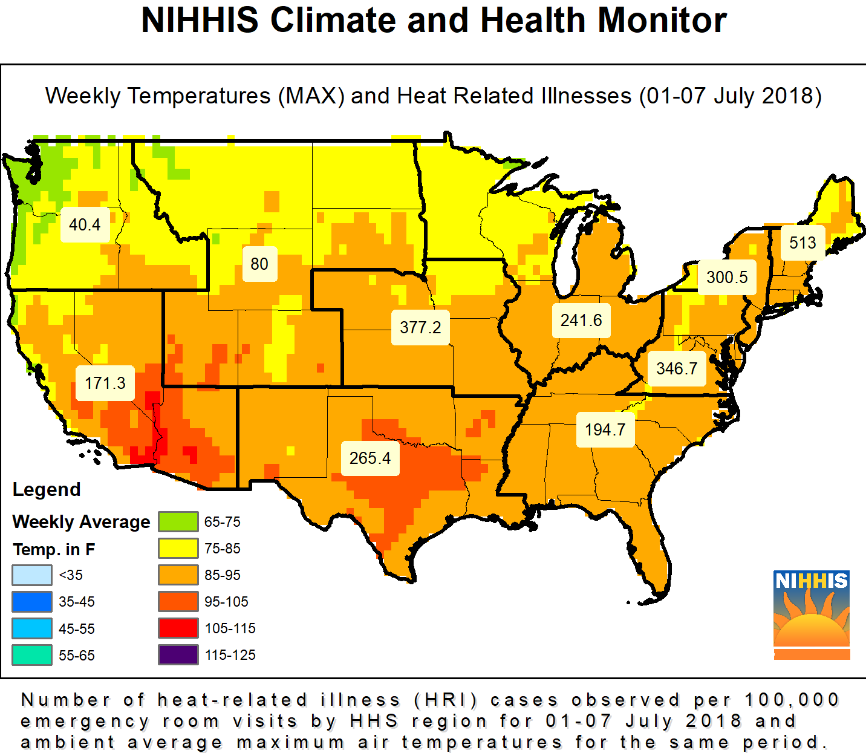

Slide 51
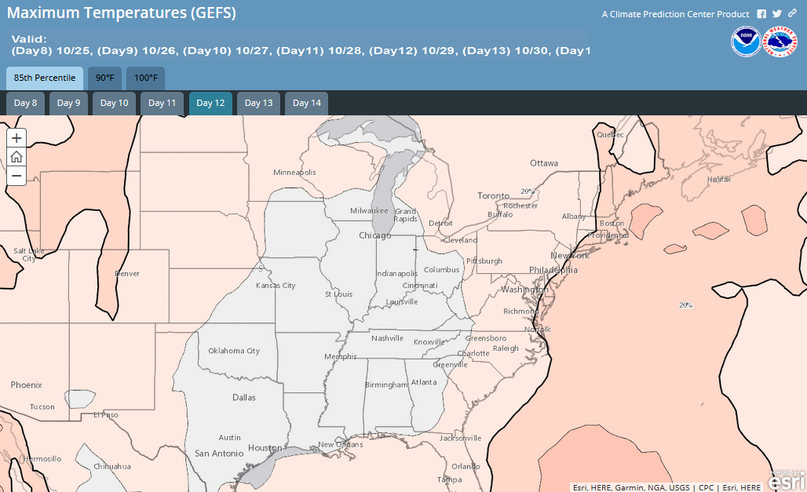
New as of October 2018: Week-2 Global Probabilistic Extremes Forecast Tool

